Slide 1
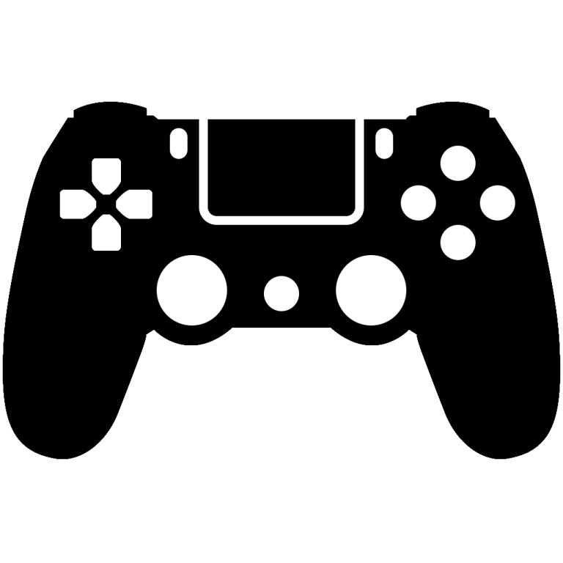
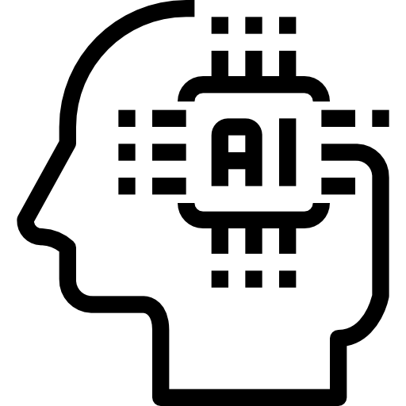
AI Adaptation
In Game Design
Adam Milewski

Slide 2
What is AI?
Simulated human level thinking done by machines
Most common form being Machine learning
AI mostly looks for patterns in given data
Notes:
“In general, AI systems work by ingesting large amounts of labeled training data, analyzing the data for correlations and patterns, and using these patterns to make predictions about future states.”

Slide 3


How is it implemented into gaming?
It is widely used in
Game production
How does AI help?
-photorealistic visuals
-content generation
-NPC’s

Slide 4
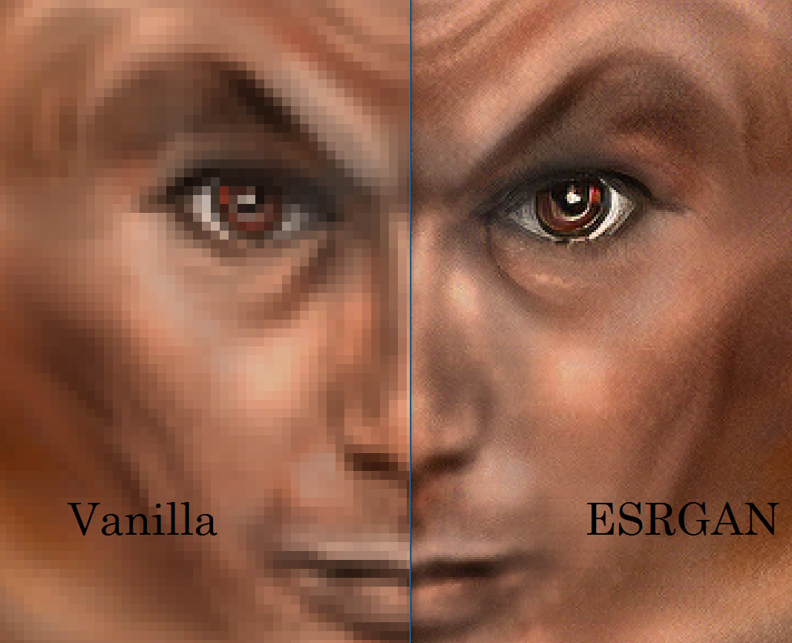
Photorealism
-Up scaled images created by AI
-Generation and continuation of pattern
-Faster than hard coded visuals
-Less demanding on the hardware
Notes:
No need for ray tracing when using AI generated graphics

Slide 5

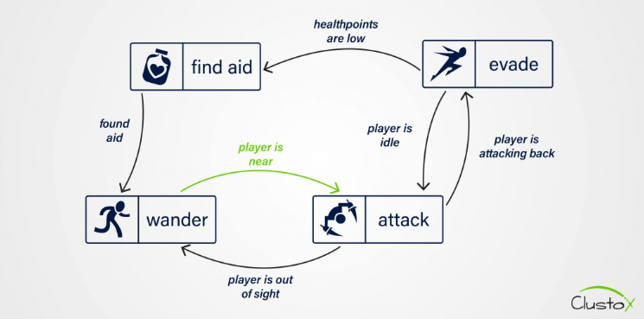
NPC’s
-AI NPC still in its infancy
-Conversation trees and scripted dialogue obsolete
-Instead AI can help power fully-formed personalities
Notes:
No need for ray tracing when using AI generated graphics

Slide 6
The effects on industry
-More automation
-Cost reduction
-New forms of NPC’s
pixelplex
“The growing popularity of AI in games also has significant business benefits for enterprises. The gaming industry is becoming one of the most profitable sectors, with a market value predicted to reach around 314 billion USD by 2026. As a result, funding of the development of AI-based games worldwide has been steadily rising.”

Slide 7
Conclusion
-Overall better visuals
-AI is beneficial in game development
-Cost reduction and faster production
-Advanced NPC’s

Slide 8

Any Questions?

Slide 9
Sources
https://pixelplex.io/blog/how-ai-enhances-game-development/
https://www.gamedesigning.org/gaming/ai-in-gaming/
https://www.techtarget.com/searchenterpriseai/definition/AI-Artificial-Intelligence
https://www.techtimes.com/articles/260199/20210513/artificial-intelligence-video-game-graphics-quality.htm
https://www.freethink.com/robots-ai/ai-npc-voice-conversations

